Slide 1
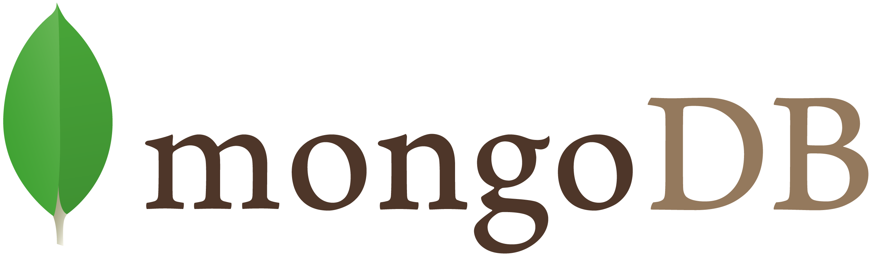

Slide 2
Outline
Family of NoSQL DBs
MongoDB profile
Basic operations
Company details

Slide 3
The family of NoSQL DBs
Key-values Stores
  Hash table where there is a unique key and a pointer to a particular item of data.
  Focus on scaling to huge amounts of data
  E.g. Oracle BDB
Column Family Stores
  To store and process very large amounts of data distributed over many machines
  E.g. Cassandra, HBase
Document Databases
  Collections of Key-Value collections
  The next level of Key/value, allowing nested values associated with each key.
  Appropriate for Web apps.
  E.g. CouchDB, MongoDb
Graph Databases
  Bases on property-graph model
  Appropriate for Social networking, Recommendations
  E.g. Neo4J, Infinite Graph

Slide 4
MongoDB profile
Document-oriented NoSQL database.
Schema-free.
Based on Binary JSON; BSON[2].
Organized in Group of Documents → Collections
  Informal namespacing
Auto-Sharding in order to scale horizontally.
Simple query language. Rich, document-based queries.
Map/Reduce support (See more at [7]).
Open Source (GNU AGPL v3.0.)

Slide 5
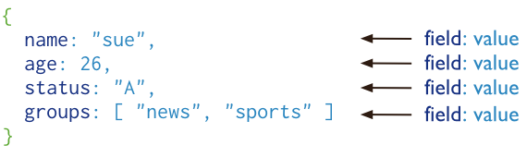
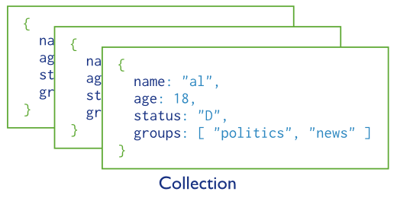
Basic operations
users
©MongoDB [3]

Slide 6
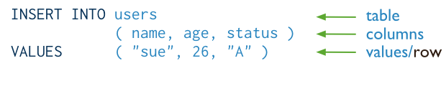
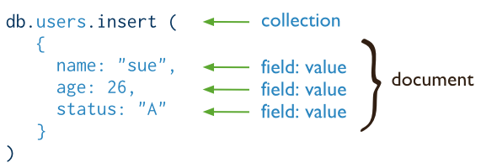
CRUD operations - create
Insert a new user.
SQL
MongoDB
©MongoDB [4]

Slide 7
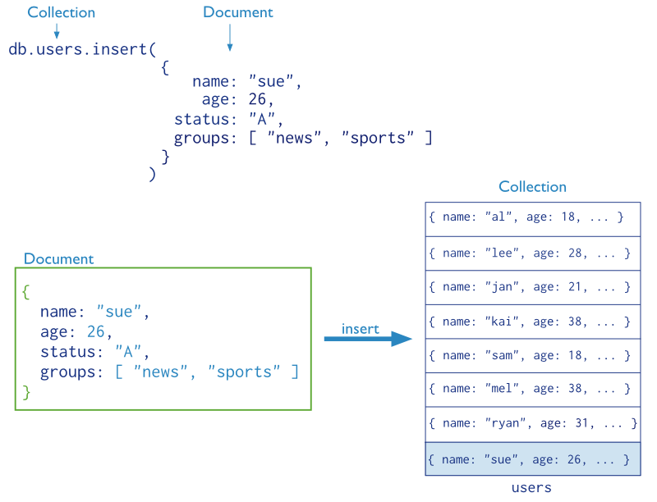
CRUD operations – create (cont’d)
©MongoDB [3]

Slide 8
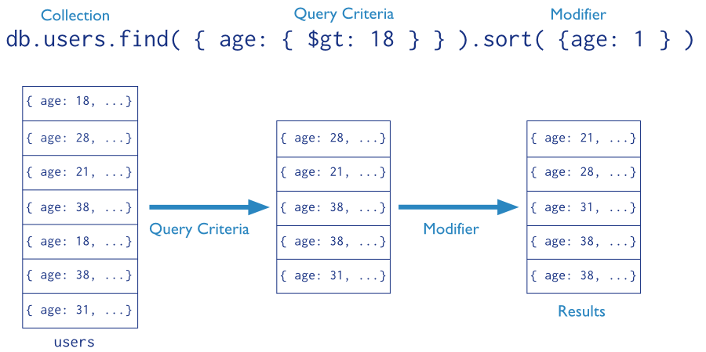
CRUD operations - read
Find the users of age greater than 18 and sort by age.
©MongoDB [3]

Slide 9

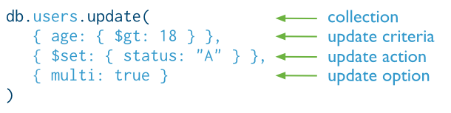
CRUD operations - update
Update the users of age greater than 18 by setting the status field to A.
SQL
MongoDB
©MongoDB [4]

Slide 10

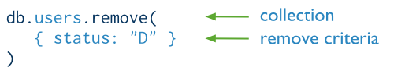
CRUD operations - delete
Delete the users with status equal to D.
SQL
MongoDB
©MongoDB [4]

Slide 11
Company details
- MongoDB is funded by leading investment firms and technology companies, including Altimeter Capital, Fidelity Investments, Flybridge Capital Partners, In-Q-Tel, Intel Capital, NEA, Red Hat, Salesforce.com, Sequoia Capital, Union Square Ventures and T. Rowe Price. [5]
- October 4th, 2013 – $150 million in funding
With more than $231 million in total investment since the company’s inception in 2007, MongoDB is now the best-funded Big Data technology. MongoDB’s financing marks the largest single funding round for any database vendor, NoSQL or otherwise. [6]
- 320 employees

Slide 12
References
[1] Mikayel Vardanyan, Picking the right NoSQL Database Tool: http://blog.monitis.com/index.php/2011/05/22/picking-the-right-nosql-database-tool/
[2] BSON Specification: http://bsonspec.org/
[3] MongoDB CRUD operations: http://docs.mongodb.org/manual/crud/
[4] MongoDB Write operations: http://docs.mongodb.org/manual/core/write-operations/
[5] MongoDB Investors: http://www.mongodb.com/investors
[6] MongoDB Closes $150 Million in Funding: http://www.mongodb.com/press/mongodb-closes-150-million-funding
[7] MongoDB Aggregation introduction: http://docs.mongodb.org/manual/core/aggregation-introduction/

